Slide 1


PCHAlliance Innovation Exchange:
Connected Home Healthcare for the Aging: Delivery and Access Opportunities
HIMSS and PCHAlliance EVENT

Slide 2

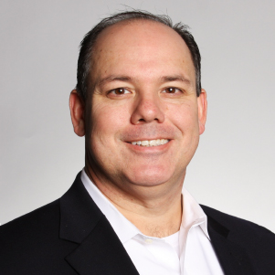
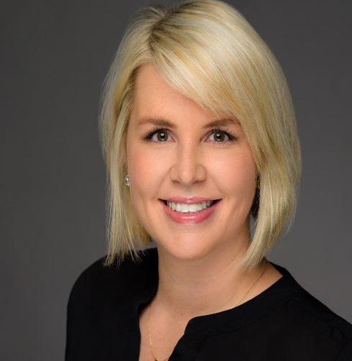
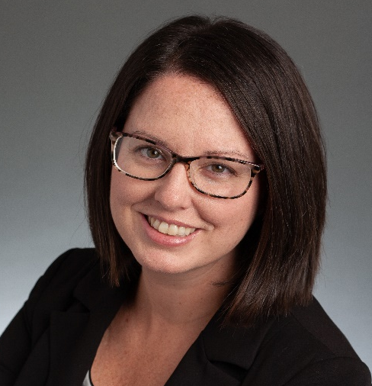

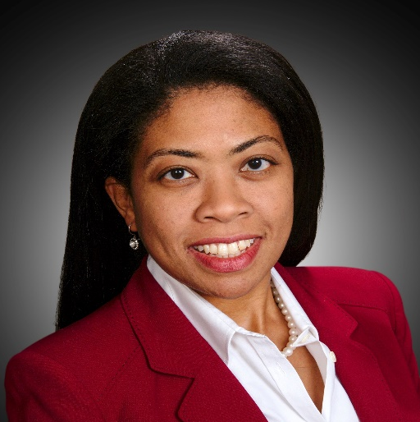
Panelists
Clint Cetti
Sarah Jones
Jennifer Kent
Ragini Kaligithi
Director of Innovation & Strategy
AT&T Business
VP Commercial Product,
Best Buy Health, Great Call
Senior Director, Pandemic Researcher
Parks Associates
Special Products Director
Charter Healthcare
Fran Ayalasomayajula
Moderator and Co-Chair PCHAlliance
Aging & Tech Task Force
Head of Population Health, Worldwide Healthcare, Strategy and Solutions
HP Inc.

Slide 3


Slide 4
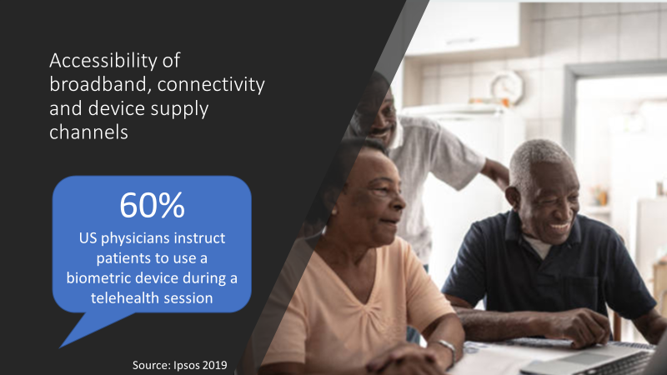

Slide 5


Slide 6


Slide 7
Questions
Please input questions
into Q&A

Slide 8
Invitation: Topic Development and Call for Panelists
Upcoming PCHA Innovation Exchange webinars:
Building Trust in Technology for Adoption of Remote Patient Monitoring to Serve the Elderly, Sept. 14, Noon CT [moderator: Nancy Green, President, The SAA Group, Co-Chair of PCHA Aging & Tech Task Force, nancymgreen@outlook.com]
Removing Adoption Barriers: Operationalizing Connected Care for Seniors and Caregivers [DRAFT program title], October 19, Noon CT
Future webinar dates: Patient Experience and SDOH topics TBD, November 16 and December 14, Noon CT
Submit topic ideas, abstracts and speaking interest for next HIMSS-PCHAlliance Aging & Tech Webinar Series: Jody Toser, PCHAlliance, jtoser@pchalliance.org

Slide 9

Announcing: HIMSS Accelerate Health Digital Series
Hosted on a New Innovation-focused Content and Connectivity Platform
Join disruptors and thought leaders for interactive bimonthly discussions that examine big ideas and ask hard questions to propel healthcare innovation forward.
Episode1, September 29th - Going Virtual: The Future of Care & Healthy Living
“Established telehealth leaders will discuss what innovations are on the horizon, and how we can ensure that underserved communities and elder populations have access to these expanding care models.”
https://www.himss.org/event-accelerate-health

Slide 10
PCHAlliance Aging & Technology Task Force participants:
AJ Assaadi, Sr. Director of Development, United Spinal Association
Fran Ayalasomayajula, Head of Population Health, Worldwide Healthcare, Strategy and Solutions, HP Inc.
David Box, Global Managing Director, Star
Nancy Green, President, The SAA Group
Rob Grenfell, Director, Health and Biosecurity, CSIRO
Jennifer Kent, Senior Director, Parks Associates
Mike Mazzola, President, Lamprey Networks
Rob McCray, HIMSS and PCHA Board Member, President, Wireless Life Sciences Alliance
Vicki Nolen, System Director, Clinical Excellence and Virtual Care, CHRISTUS Health
John Sharp, Director, Thought Advisory, HIMSS-PCHAlliance
Alexia Sibony, Vice President Product, Orbita
Jody Toser, Director of Membership, HIMSS-PCHAlliance
Monica Volante, Director, Federal Government Affairs, Philips
Charlotte Yeh, Chief Medical Officer, AARP Services, Inc.

Slide 11
Resources
HIMSS and PCHAlliance COVID-19 initiatives and pages
Industry Call to Action sources, Resources for Individuals, Providers and Vendors – updated continuously
    http://www.pchalliance.org/covid-19-resources
    https://www.himss.org/news/coronavirus
HIMSS20 Digital: Education, innovation and collaboration of the HIMSS Global Health Conference & Exhibition https://www.himss.org/events/himss-digital
HIMSS Analytics Digital Health Indicator https://www.himssanalytics.org/dhi
2. Personal Connected Health Alliance (PCHAlliance), a HIMSS Innovation Company www.pchalliance.org
  Member Engagement and Thought Leadership on Connected Health: Aging & Technology, US Policy including CARES and telehealth, Regulatory including FDA Pre-Cert, European Initiatives like mHealth Hub, Connected Device Interoperability Standards including Continua and IHE
3. HIMSS Learning Center – HIMSS20 and ongoing programming (https://www.himsslearn.org//)

Slide 12
Speaker Contact Information:
Fran Ayalasomayajula
Head of Population Health, HP
frances.a.walls@hp.com
Clint Cetti
Director of Innovation and Strategy, AT&T
cc1245@att.com
Sarah Jones
VP Commercial Product, Best Buy Health, GreatCall
Sarah.jones@greatcall.com
Ragini Kaligithi
Special Projects Director, Charter Health Care
raginikaligithi@charterhcg.com
Jennifer Kent
Senior Director, Pandemic Researcher, Parks Associates
Jennifer.kent@parksassociates.com

Slide 13

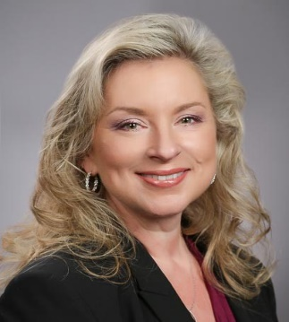
Thank You!
Recording will be sent to all registered participants
Webinar webpage:
https://www.himsslearn.org/connected-home-healthcare-aging-delivery-and-access-opportunities
Tune In…
Monday, Sept. 14th at 1pm EST
Building Trust in Technology for Adoption of Remote Patient Monitoring to Serve the Elderly
More info at himsslearn.org
Nancy M. Green
Moderator & Co-Chair PCHAlliance
Aging & Tech Task Force
President, The SAA Group

