Slide 1
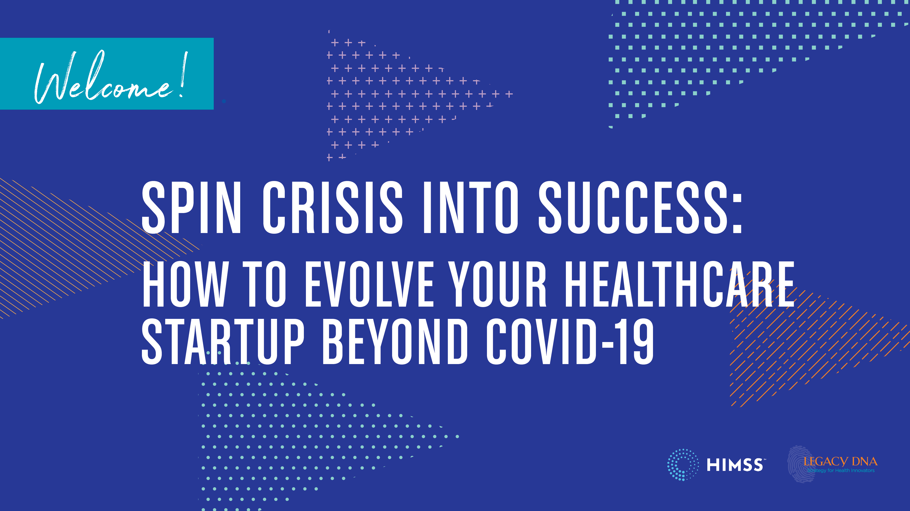

Slide 10
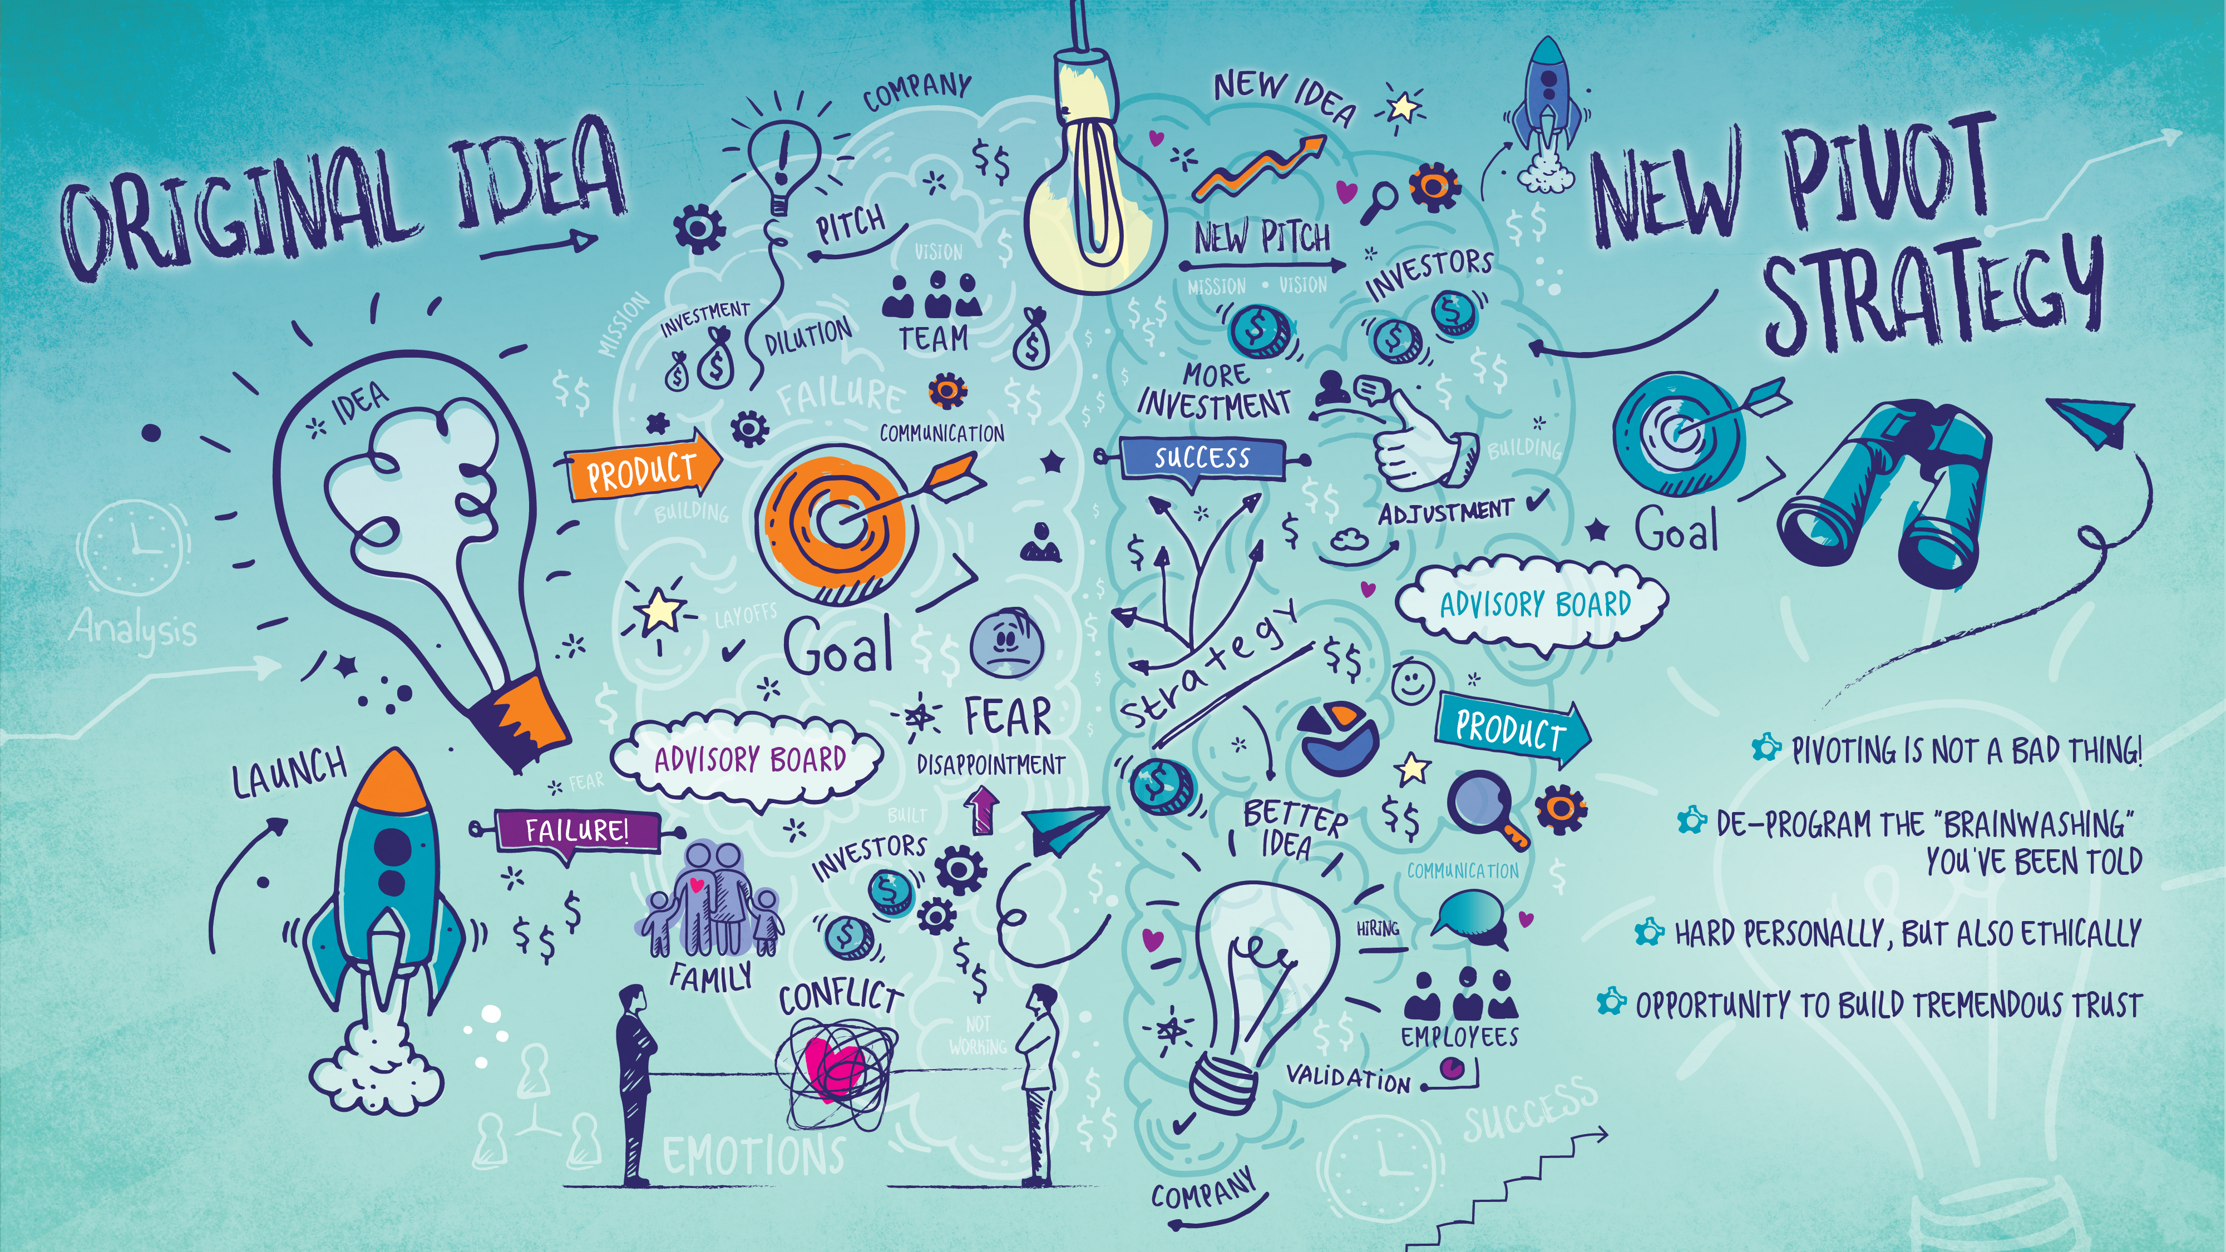

Slide 17
Where are you right now in the pivoting process?
a) We assessed our strategy and we don’t need to pivot.
b) I'm not sure if it's the right thing to do right now.
c) We're exploring all of our options.
d) We've started comparing and validating our most viable options.
e) We're executing our pivot strategy.

