Slide 1

Liquidity and the Business of Peer-to-Peer
September 2020

Slide 2



Emily Bailey
DLTA PRODUCT DIRECTOR
Kelly Cavin
SOCIAL DETERMINANTS OF HEALTH, VICE PRESIDENT
Rohan Rangel
MEDICAL NETWORKS, DIRECTOR OF PRODUCT MANAGEMENT

Slide 3
Unparalleled Reach Across Healthcare
3,300+
Facilities using
Imaging Solutions
1,000,000
Physicians
Customer
Outcomes
Data &
Insights
39,000
Pharmacies
$1.5 Trillion
Healthcare Claims
Payers
125,000
Dentists
Network
Ecosystem
15 Billion
Healthcare
Transactions
700
Laboratories
Providers
Consumers
1 in 3
U.S. Patient
Records
6,000
Hospitals
2,400
Payer Connections
Connectivity
Leading analytics solutions
Pervasive network providing insights
Leading payer and provider relationships
One of the largest healthcare financial and administrative networks in the United States
Notes:
Insert Change Healthcare messaging
Size of our network, and network is what powers our network and services

Slide 4

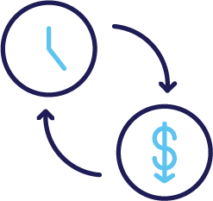
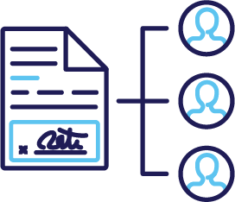
Unparalleled Reach Across Healthcare
Claims Lifecycle Transparency
B2B Payment Reconciliation
Blockchain Infrastructure and API Services
Notes:
claims lifecycle transparency, b2b payment reconciliation with smart contracts → what’s the business case for a shared network?
We’ve done a lot of technology development

Slide 5
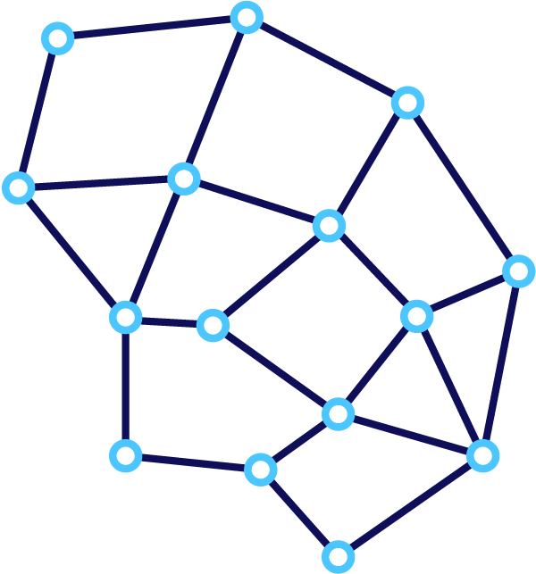



What We’ve Learned
The “next paradigm” of innovation is digital and rooted in consumer-centric design.
Blockchain technology works better as the basis of application design.
If the value is “off-chain” so is the business case.
Notes:
We discovered a few things… H3 , infrastructure / digital networking, digital assets new paradigm
Past use case analysis: 30+ use cases evaluated in 2019 with varying degrees of innovation, impact and feasibility. Blockchain is H3 technology. How innovative? Very. We’re not shooting for incremental improvement; this is a moonshot.
The next paradigm of innovation doesn’t ”think” like the current market. Healthcare consumers whose experience of health and wellness originates outside the brick-and-mortar doctor’s office will seek a consolidation of those services/experience to something more wholistic and personalizable and inevitably virtual / mobile. According to amazon, consumers value cost, convenience and choice – healthcare in the modern world offers none of those benefits. It is ripe for paradigm shifting disruption.
Blockchain technology is network infrastructure. It’s not optimized to be a secondary reporting environment, but rather the basis of truth in an application’s protocol. To be successful in designing a network with partners, we have to create an ecosystem of value.
There’s a cost to running blockchain infrastructure, so there must be a value to it, an inherent one, that is measurable and empirically evident. The more adjudication, processing, authentication, exchange, value, etc that lives on-chain, the more value the blockchain inherently secures. So processing transaction fees is justifiable, where if all the processing happens off-chain and storage accumulates on-chain, it becomes confusing who should pay for that. Aka put the adjudication logic on-chain, do the payments on-chain using tokens, represent policies as smart contracts that automatically pay out… etc.

Slide 6

We Talked to Our Customers About Trends in Innovation
“Can’t we just have one system of record?”
“I just want to stop bad transactions before they happen.”
“I would accept a reduced rate for instant settlement.”
“Yes, but my hands are tied with my EHR.”
“Efficiency’s great, but how can we get real change?”
“What works for them doesn’t work for me, because our business is different.”
Notes:
Customers say it’s not enough “to make claims / payments faster,” they want to see innovation that changes behavior

Slide 7


Lasting innovation must create an incentive to change behavior.
Notes:
In order for us to understand the impact of blockchain technology and applications like cryptocurrency in healthcare, we have to understand what decentralization means in our industry. Most people don’t know, and the answer shouldn’t be obvious. So we asked ourselves, where have we seen this type of disruption before?

Slide 8
What Market Forces Could Be so Powerful in Healthcare?
Liquidity (noun)
how quickly an asset can be bought or sold in the market at a price reflecting its intrinsic value. In other words: the ease of converting it to cash.
Notes:
This is what blockchain technology addresses in finance, and in general, it’s what peer-to-peer networks do. Liquidity is an investing term, but it can apply to information as well.
Taking some creative license with the Investopedia.com definition
https://www.investopedia.com/terms/l/liquidity.asp

Slide 9




Liquidity in Healthcare
How easy is it to convert our assets
into cash, or the equivalent?
Healthcare Goods and Services
Patient and Provider Identity Information
Insurance and Financial Services
Audits and Insights

Slide 10
Liquidity in Healthcare
Does it get easier or more difficult
if patients are involved?
Healthcare Goods and Services
Patient and Provider Identity Information
Insurance and Financial Services
Audits and Insights

Slide 11
Liquidity in Healthcare
Does it get easier or more difficult – for your business – if insurance is involved?
Healthcare Goods and Services
Patient and Provider Identity Information
Insurance and Financial Services
Audits and Insights
11

Slide 12

Liquidity depends on
frictionless exchange.
Enter peer-to-peer networks.
Notes:
In order for us to understand the impact of blockchain technology and applications like cryptocurrency in healthcare, we have to understand what decentralization means in our industry. Most people don’t know, and the answer shouldn’t be obvious. So we asked ourselves, where have we seen this type of disruption before?

Slide 13
Where have we seen this type of decentralization before?
Notes:
In order for us to understand the impact of blockchain technology and applications like cryptocurrency in healthcare, we have to understand what decentralization means in our industry. Most people don’t know, and the answer shouldn’t be obvious. So we asked ourselves, where have we seen this type of disruption before?

Slide 14
MP3: Be Your Own Radio
2018
Streaming
Subscribe for Ad-free
Access to Everything
2005
iTunes and YouTube
Portability at
Industry Price
/ Publish Music
for Free
1999
MP3
Digital Asset
Disruption
Notes:
Music industry - We’re doing a podcast series on this topic, so spoiler alert…
Digital Asset Disruption:
MP3 and torrent files downloaded from peer-to-peer networks, burned to CDs or uploaded to MP3 players
First wave: iTunes – Purchase licensed MP3s for “1,000 songs in your pocket.”
Big Winner: Streaming Services, Publishing Platforms, Artists, and Advertisers
Why: Markets find a way to simplify the Job To Be Done, in this case “listening to music” and “creating music.”
Consumers didn’t really want portability. They wanted personalized listening, which requires having access to the most available options. And they would not pay the music industry prices. Subscription services came first. And then streaming.
Artists went online, using social media and content platforms like YouTube to gain a following. Today, entertainment content has never been so diverse, and the opportunity for artists has never been greater.
while much of the focus is on the consumer disruption of music, consider the artist, the creator, the source of value. In the new paradigm, their options to grow their business, market themselves and adapt their craft have never been greater. We believe this is the opportunity decentralization presents in healthcare, and we’re calling it “provider liquidity.”

Slide 15
Consider the artist.
Their options to grow their business,
market themselves, and adapt their product have never been greater.

Slide 16



In Healthcare, Who Benefits From Liquidity?
“The Delighted End-User”
“The Empowered Provider”
“The Money Manager”
Low-cost
Convenient
Customizable
Instant utility
Provide care
Collect revenue
Prevent illness
Control costs
Empower members
Prevent Fraud, Waster & Abuse
Grow wealth
Notes:
We’ve identified several more stakeholders, and believe there are specific corresponding application types suited for those users
And we believe there are corresponding application types suited for those users
Incentives must realign, and that won’t just happen overnight:
Payers will need to mitigate their risk through new financial products
Providers will want want proof of value before changing prices
Patients / consumers require careful planning and design
Designing blockchain solutions without reworking incentive is why so many projects end up in #ForeverR&D
Our goal will be to design a decentralized remittance processing service for real-time payments – allowing txn processors to earn network fees and provide on-network financial products to reduce leakache and friction in claims payments

Slide 17
Ultimately, Liquidity Can Benefit the
Entire Healthcare System
Price competition lowers costs
Incentive to provide best possible care
More variety of services
Instant utility or delivery of service
Clear and intuitive engagement
Notes:
If no one knows what anything costs, no one can be responsible.
If everyone knows what everything costs, everyone can be responsible.

Slide 18









Information Liquidity Accelerates Decision Making
When the claim contract is complete, all parties are notified. The Blockchain maintains a real-time immutable record of the claims lifecycle.
011001
The Patient makes a payment
CONSUMER
011001
011001
PAYER
PROVIDER
The Payer creates the rules for its claims and publishes it as a contract much like sharing a standard.
The Provider treats a patient and submits a claim according to the contract
The Processor processes the claim and submits the claim to the Payer for approval.
011001
PROCESSOR

Slide 19



Financial Liquidity Reduces Friction Between People and Businesses
Price discovery and instant conversion are necessary for a liquid marketplace.
Digital, consumer, and retail health and pharma are ideal markets to pilot this.
Benefits:
Instant settlement of payments
Reduced time in Account Receivable
Competitive, transparent and dynamic pricing
Increased auditability of payment events
Extensible to consumer devices
BANK
PAYER
PROVIDER
PROCESSOR

Slide 20
Emily Bailey
DLTA PRODUCT DIRECTOR
Kelly Cavin
SOCIAL DETERMINANTS OF HEALTH, VICE PRESIDENT
Rohan Rangel
MEDICAL NETWORKS, DIRECTOR OF PRODUCT MANAGEMENT

Slide 21



What’s next?
Applications are open for select beta partners for the CBO Marketplace SDK this October.
Applications are open for select beta partners for the Claims Orchestration pilot this December.
We will follow-up this webinar with an email for people to express interest in these areas.
© 2020 Change Healthcare LLC and/or one of its subsidiaries. All Rights Reserved.

