Slide 1
Documentation Burden: Healthcare IT Innovations to Optimize Clinician Documentation in Care Delivery
HIMSS Nursing Informatics Community Webinar
October 12, 2021

Slide 2

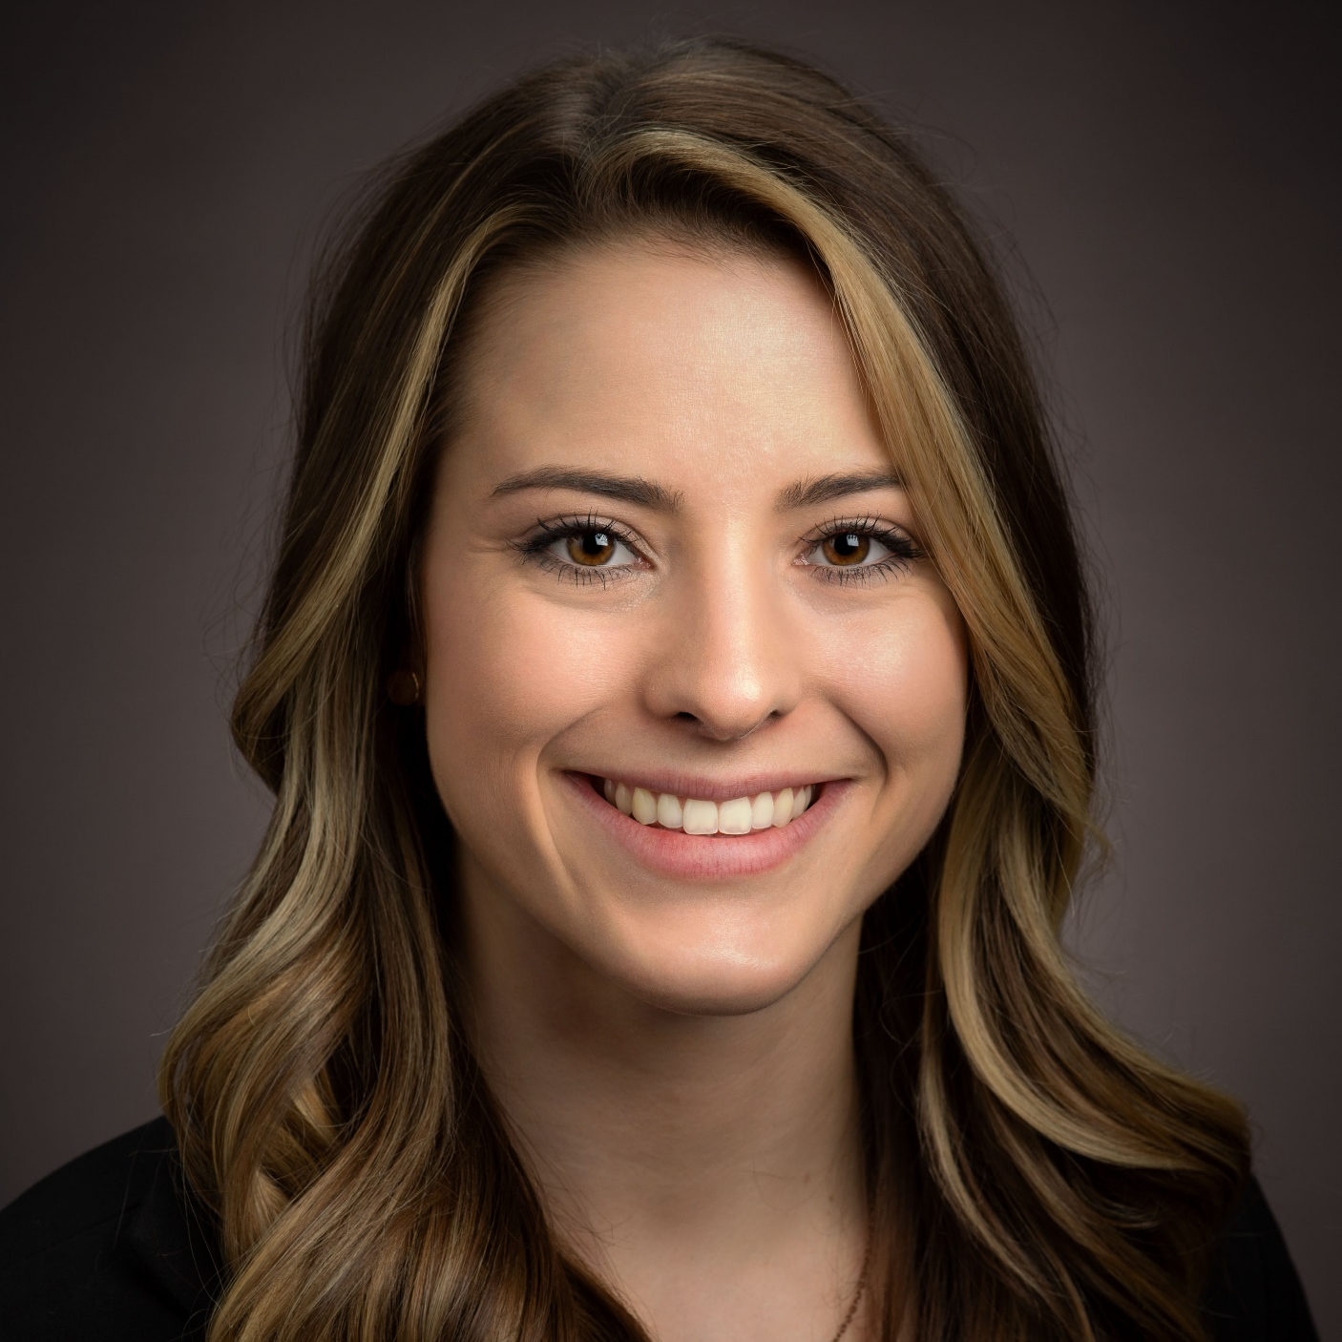
Welcome
Cait Michicich, MBA
Program Manager, Clinical Informatics, HIMSS

Slide 3
HIMSS Nursing Informatics Community
The Nursing Informatics Community’s purpose is to articulate a cohesive voice for the HIMSS Nursing Informatics community and to provide domain expertise, leadership and guidance to HIMSS activities, initiatives, and collaborations with the global nursing informatics community.
Educational webinars qualified for CA/CPHIMS on nursing informatics topics and emerging trends
www.HIMSS.org/NI
#Nurses4HIT
Notes:
Invite you all to join HIMSS as an individual or through your organization

Slide 4

Join us on Accelerate!
Join Accelerate today at YourAccelerate.com
Accelerate is a natural extension of HIMSS's origins and foundation as a member-driven society, and is an innovative solution aimed to support members, partners and the global health ecosystem 365 days a year.
Register with your email, password and personal invite code: MVPNI
Notes:
ADD THE UNIQUE LINK TO JOIN

Slide 5

Thank you

Slide 6
Agenda
Introduce moderator and speakers
Facilitated panel discussion
Engage in dialogue of Q&A from the attendees

Slide 7

Learning Objectives
Discuss perspectives on documentation burden as it relates to clinician and interprofessional resource activity in healthcare delivery.
Understand the domains of burden related to magnitude, directionality, tasks, and time impacting clinicians around the constructs of EHR time, work outside of work, inbox time, teamwork for orders, and undivided attention to patients.
Review innovative ideas to address documentation burden for specific groups of clinicians (nurses, physicians) and in the interdisciplinary work of clinicians.

Slide 8


Welcome
Kelly Larrabee-Robke, RN, MBA, MS​
US Chief Nursing Officer​
Microsoft Health & Life Science Industry Team​

Slide 9



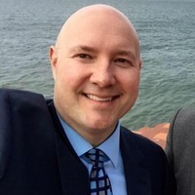
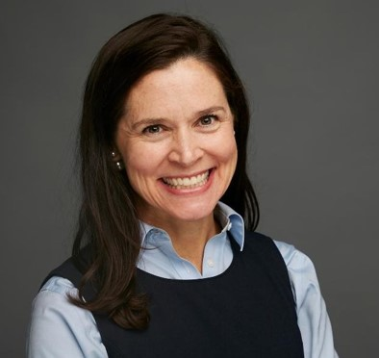
Meet Our Webinar Panelists
Kelly Robke, MBA, MS, RN
Seraphine Kapsandoy, RN, PhD
Jud Simonds, RN-BC,
NE-BC, DNP
Victoria Tiase, RN-BC, PhD
US Chief Nursing Officer
Microsoft
Chief Clinical Information Officer
Intermountain Health
Director, Nursing Informatics
University of California-
San Diego Health System
Director, Research Science
New York Presbyterian Hospital
Notes:
Brief intro to session

Slide 10
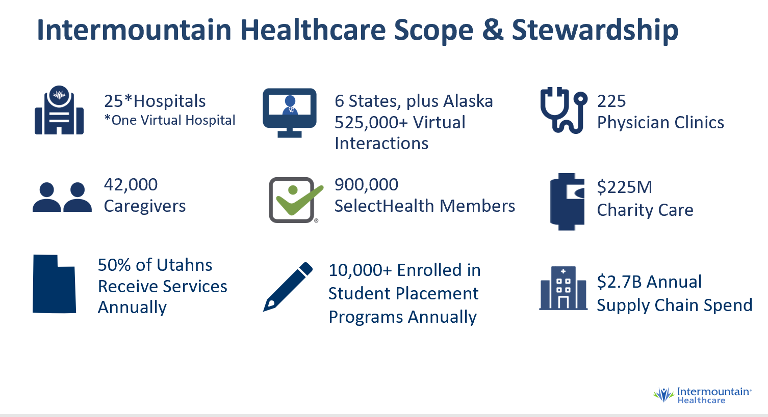
Practice Environment
Intermountain Health System
Notes:
Seraphine-intro, role, organization, opportunities for documentation focus

Slide 11

Practice Environment
University of California San Diego Health
  Inpatient and specialty care throughout the San Diego region, as well as primary, urgent and express care at clinics throughout the area
  Campuses:
      UC San Diego Medical Center (390 beds)
      Jacobs Medical Center(364 beds)
      Sulpizio Cardiovascular Center (54 beds)
      Shiley Eye Institute, Moore’s Cancer Center, and the Koman Family Outpatient Pavilion
  Ranked #1 in San Diego, and #5 in California with 10 medical and surgical specialties rated among nation’s best, placing UC San Diego Health among the nation's best hospitals, (2021-2022 U.S. News & World Report)
  UC San Diego Health has received Magnet hospital designation from the American Nurses Credentialing Center (ANCC) since 2011
  Top 10 Vizient ranking since 2019
Notes:
Jud-intro, role, org and focus/interest related to documentation

Slide 12
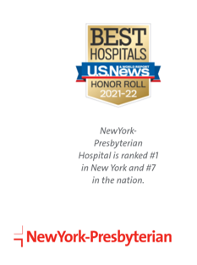

Practice Environment
New York Presbyterian Health System
  NYPH is composed of seven campuses located in and around New York City
    Academic Medical Center with two renowned medical schools, Weill Cornell Medicine and Columbia University Vagelos College of Physicians and Surgeons
    2,600 patient peds
    2 million inpatient and outpatient visits
Notes:
Vicky-documentation burden, role, org; academic and association work in area

Slide 13
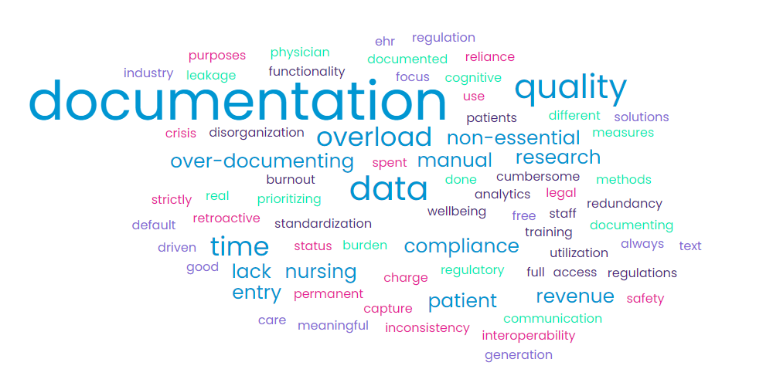
Your insights
Pain points with documentation-audience insights

Slide 14



Creating the culture and climate for change
Notes:
Will focus on question 4 content and comments added by Seraphine to email

Slide 15
Culture and Climate
“Innovation does not occur in isolation, but it is an art and science sustained through an organizational climate and culture.” (Joseph, 2015)
“Organizational culture reflects the basic assumptions about the world and the values that guide life in organizations.”(Schneider, B., Ehrhart, M., Macey, W., 2013)
“Organizational climate describes the meanings people attach to interrelated bundles of experiences they have at work.”(Schneider, B., Ehrhart, M., Macey, W., 2013)
Notes:
All Provide perspectives on Culture-
Explore the culture and climate factors that enable documentation burden
Opportunities to initiate, evolve and ignite change and evolution (Seraphine)
cross clinical collaboration on crisis docs (all)
waivers; element of trust (Seraphine)
shifting from time value to efficiency measures or assessment (Vicky)
Shifting the culture specifically related to technology design and adoption – Jud
Making it easier for clinicians and patients to make a certain decision-All
Identifying behavioral events of daily workflows-All

Slide 16
Enabling meaningful change through collaboration
Notes:
Items 2/3 of email

Slide 17
Organizational initiatives
1
Committees and Workgroups
2
Shifting focus from collection to workflow
3
The role of technology
Examine workflows, potential challengers to change
Identify key value drivers, gain leader buy-in
Process and rationale for collecting information
Evaluating rationale for Why is information being collected
Understanding legal, regulatory, and financial implications of choices
Determine how to fully integrate technologies,
Understand differences between improvements and optimization
Identify when hidden additions to documentation occur when new technology is added to the care environment
Notes:
How to overcome documentation burden from an organizational perspective-All
Leaders-Seraphine
Committees (All)
Practice Committees
What is true essence of workflow? What are barriers to optimization (ie Infection control, EMR vendor); look at primary and related workflows and process; reduction of work timing; nursing and leader advocacy
Impact of COVID in identifying sources for reduction of documentation-education, etc. State or institutional versus national; unknown impact of removal, and do they need to return (McBride survey)
Quality (All)
Though process shift from EMR centric documentation (data) to the environment of documentation; workflow alignment versus collection methods
Legal/Risk (all)
Financial/Reimbursement (all)
IT
Integration from devices (detailing true benefit of interop); Introducing benefit but not truly optimizing workflows
Emergence of additional, hidden (external to EMR) documentation requirements
How we can challenge technology companies
Considering the act of copying forward (ie assessments)

Slide 18
Extending patient experience through documentation
Notes:
From question 5

Slide 19
Patient sourced information
Direct Completion of history, medications
Patient self service as enabling factor for telehealth
Impact of patient generated info on staffing
API Implications
Impact of Information Blocking
Leveraging PGHD
Notes:
Bringing patients into care via documentation (Vicky and all)
(direct completion of documentation (ie histories, current meds, etc) outside of the EMR
patient self service-can influence live/telehealth visit
how will engaging the patient in documentation impact future staffing – leverage PGHD and shared decision-making tools
d. Impact of information blocking/open API regs

Slide 20
Clinical informaticists as advocates and leaders
Notes:
Questions 6 (promising new technologies) and 7

Slide 21
The role of informaticists in technology and documentation
Innovative Technology
Ambient Voice
Automation
Robotic
Intelligent
Patient Care
Smart IV Pumps
Ventilators
Sensor
Notes:
Promising technologies (Jud)
Ambient voice
automation integration Robotic process automation and intelligent automation
FHIR APIs
other (IV Pump integration, Biomedical devices (ventilators/vital sign machines), requires validation, but reduces manual entry time
EHR companies are providing more detail on where/how much time clinicians are spending in all areas of the EHR to assist with documentation burden knowledge and where to focus

Slide 22
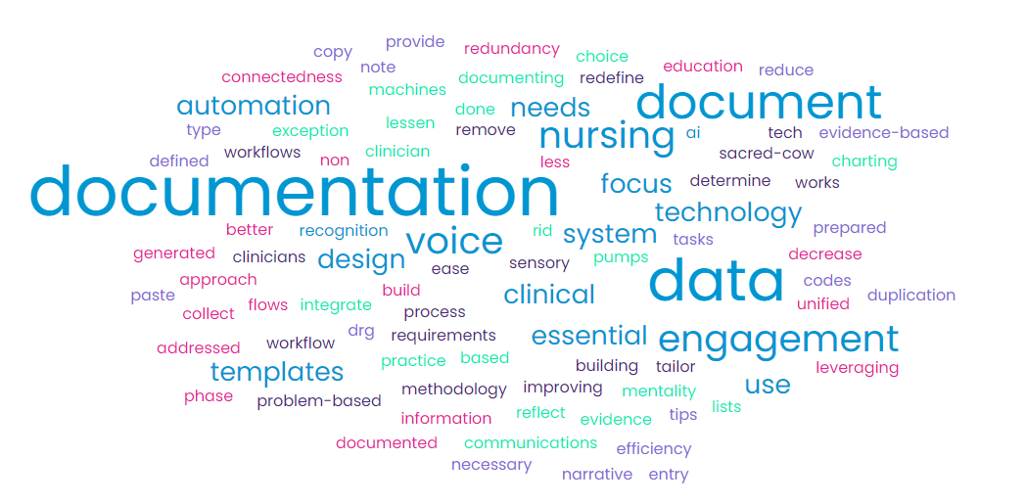
Your insights
Ideas to address documentation burden-audience insights

Slide 23
Questions?

Slide 24

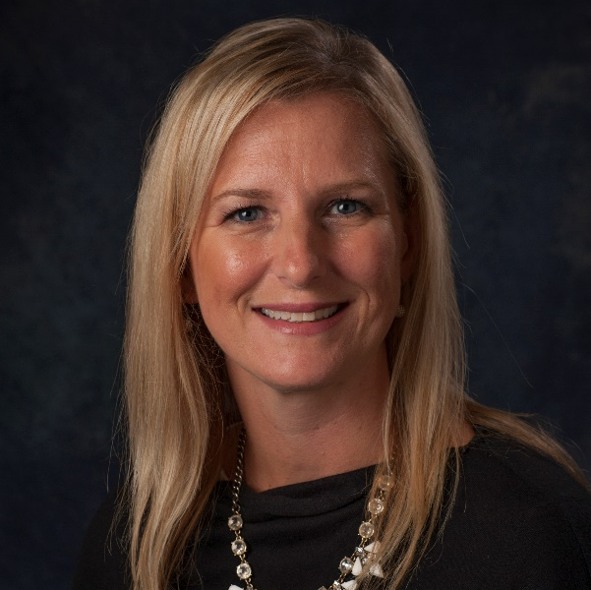

Contact us!
Cait Michicich, MBA
Tammy Kwiatkoski, MBA
Kelly Larrabee-Robke, RN, MBA, MS​
Program Manager, Clinical Informatics, HIMSS
Director, Clinical Informatics, HIMSS
US Chief Nursing Officer, Microsoft
cait.michicich@himss.org
tammy.kwiatkoski@himss.org
kellyrobke@microsoft.com

Slide 25
Thank you!
Notes:
THANKS ALSO TO CHANGE HEALTHCARE FOR SPONSORING THIS INFORMATIVE WEBINAR.
Thank you all for joining us. We hope today’s discussion helps you with your own health system’s enterprise imaging buying decisions.

