Slide 1
Practical Interoperability
November 17, 2021

Slide 2
Vision
Mission
To realize the full health
potential of every human, everywhere.
Reform the global health ecosystem through the power of information and technology.

Slide 3
Welcome Gwynne Jelbaoui Program Manager
Clinical Informatics HIMSS Gwynne.Jelbaoui@himss.org

Slide 4
Physician Community
Education
Community
Present webinars on telehealth, medical informatics, clinical decision support and best use of EHR systems
Volunteer efforts include –CMIO Roundtable & Workgroups, Clinician Circle (ambassador)
Thought Leadership
CMIOs
Value of CMIO; CMIO Roundtable
Policy input, interviews with HIMSS Media; Pre-Con Symposium Planning
Physician Community
Education Task Force
Physician Resources
Drive education and content for Community
Career profiles, education, articles, blogs
Strategic Partners
AMDIS, PEHRC with CMSS, AHA
www.himss.org/membership-participation/physician

Slide 5
Donna Houlne, RN, BSN, MHA, MHRM
Vice President HealthCare Alliance and Clinical Leader
Infor

Slide 6
Practical Interoperability Learning Objectives
Gain a better understanding of workflows to help ease challenges clinicians face with interoperability.
Understand the impending regulations that will impact clinicians.
Gain a better perspective on the patient experience when it comes to interoperability.

Slide 7
Alex Holston, MD, BiHG Fellow, CMIO
Chief Medical Informatics Officer
DoD Healthcare Management System Modernization
Fellow
Blockchain in Healthcare Global

Slide 8
Holly Miller, MD, MBA, FHIMSS
Chief Medical Officer
MedAllies
Inaugural member of the HIMSS World Wide Board
HIMSS

Slide 9
Steven Lane, MD, MPH, FAAFP, FAMIA
Clinical Informatics Director, Privacy, Information Security and Interoperability
Sutter Health
Chair of the Board of Directors
The Sequoia Project

Slide 10
Brian Levy, MD Lead Physician Executive Cerner Telemedicine Provider Global Services HIMSS Physician Committee Member
Facilitator

Slide 11
Panel Discussion

Slide 12
Questions from the attendees?

Slide 13
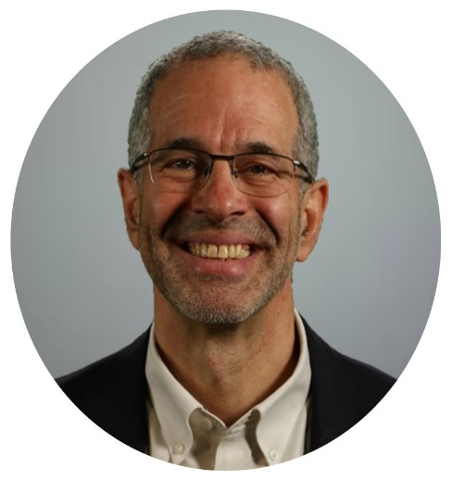
Thank you speakers!
Donna Houlne, RN, BSN, MHA, MHRM
Alex Holston, MD, BiHG Fellow, CMIO
Holly Miller, MD, MBA, FHIMSS
Steven Lane, MD, MPH, FAAFP, FAMIA

Slide 14
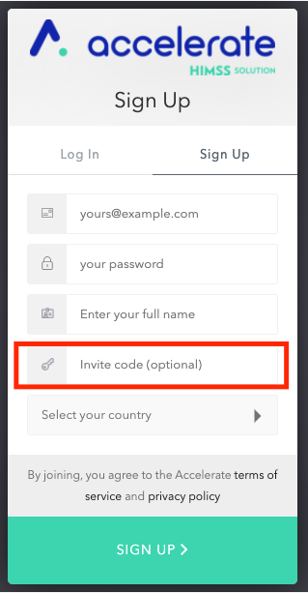
Join Accelerate and the Physician Community www.youraccelerate.com Use PHYSCOM in the Invite code field Accelerate is grounded in connecting our evolving community to provide opportunities for professional networking and development, thought leadership and research, and supporting digital transformation.
Notes:
[

Slide 15
Thank you! Contact emails: Physician Community informatics@himss.org Gwynne Jelbaoui Gwynne.Jelbaoui@himss.org

Slide 16
Appendix

Slide 17
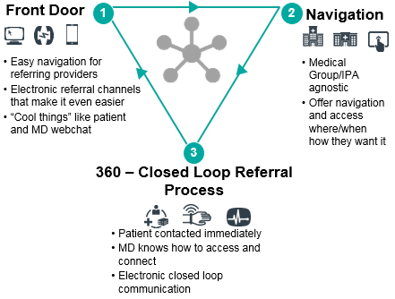
Sutter Specialty Network Referral Service - Utilizing interoperbility to provide better care coordination and the highest service levels with referrals
Sutter Specialty Network Referral Service
Sutter Health
Serving more than 100 communities across Northern California, Southern Oregon and Hawaii, Sutter Health is a not-for-profit integrated health care delivery system with 24 Acute Care Hospitals
More than 5,000 physicians within the Sutter Medical Network including our Medical Foundations and IPA Physician Organizations with over 48 different electronic health Applications in our network.
Sutter Specialty Network (SSN) Referral Service
58,000 patients served by the Sutter Specialty Network in the last 12 months; 16,000 (27%) facilitated using Direct Secure Messaging.
SSN is leading in the referral space on a national level in the use of advanced processes and interoperability channel toolswithin an integrated network.
Through a partnership with informatisists, IS, Care Centers and various referral teams, SSN has created a roadmap for the exchange of referrals across our network.
If we are to ever reduce our dependency of the fax, we must overcome a debillitating reliance on traditional referral workflows within operations
We must think of Direct as automation for referrals and another lever to pull that creates fewer touches and faster turn around times.
When referrals are managed using a Direct worflow there is a reduction of 150 keystrokes per patient, saving 2-3 days of processing time per referral.

Slide 18
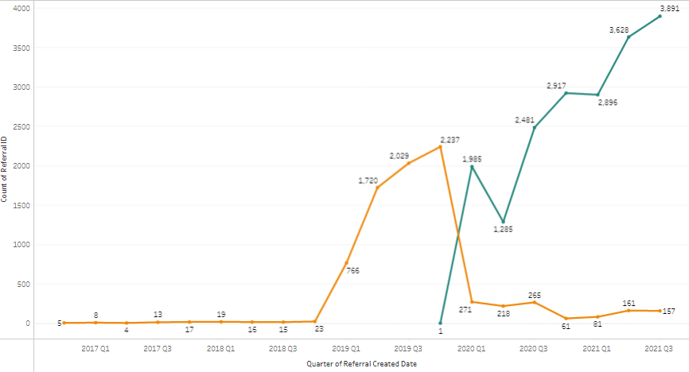
The referral service continues to spread and adopt bidirectional referral workflows across the network
SSN started a pilot in 2019 with a few high volume referring groups who were not Epic using organizations and then officially started to support Direct referral workflows in Q4 2019 with further acceptance in 2020.
Interop Referrals without the referral service
Greatest challenge remains the level of interest for a sender or receiver to transition from fax to Direct.
Referral workflows are different than Transitions of Care and require more information and more involvment. The spread and adoption of this workflow requires close partnership.
Some electronic health record vendors meet ONC certification requirments but fall short in their support of bidrectional messaging functionality and other workflows needed for referrals.
Closed loop referrals via Direct using the referral service
Reconfig of TOC Referral Context routing rules for a few departments
Pilot using SSN to facilitate Referrals
1st Covid shelter in place
Official Workflows put in place
9

