Slide 1
It’s a Matter of When: Responding to a Ransomware Attack
A Tabletop Discussion for Nursing Informatics Professionals​
HIMSS Nursing Informatics Community
October 13, 2022

Slide 2


Welcome
Cait Obenauf, MBA
Program Manager, Clinical Informatics, HIMSS

Slide 3
HIMSS Nursing Informatics Community
The Nursing Informatics Community’s purpose is to articulate a cohesive voice for the HIMSS Nursing Informatics community and to provide domain expertise, leadership and guidance to HIMSS activities, initiatives, and collaborations with the global nursing informatics community.
Educational webinars qualified for CA/CPHIMS on nursing informatics topics and emerging trends
www.HIMSS.org/NI
#Nurses4HIT
Notes:
Invite you all to join HIMSS as an individual or through your organization

Slide 4







Join the HIMSS Nursing Informatics Community
Apply for the HIMSS Nursing Informatics Committee
https://www.himss.org/membership-participation/nursing-informatics-community
https://www.himss.org/membership-participation/nursing-informatics-committee
Ways to get involved at HIMSS
as an informatics nurse
Submit a manuscript to the Online Journal of Nursing Informatics
Join the HIMSS Nursing Informatics Education & Networking Task Force
https://www.himss.org/resources/online-journal-nursing-informatics
Reach out to Cait Obenauf at cait.obenauf@himss.org
Attend an upcoming webinar or coffee chat
Get involved with your local HIMSS Chapter
https://www.himss.org/events
https://www.himss.org/membership-participation-chapters

Slide 5
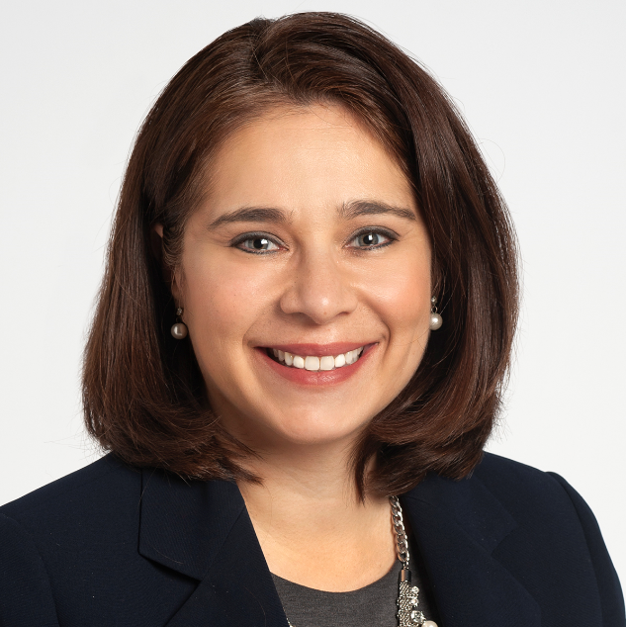
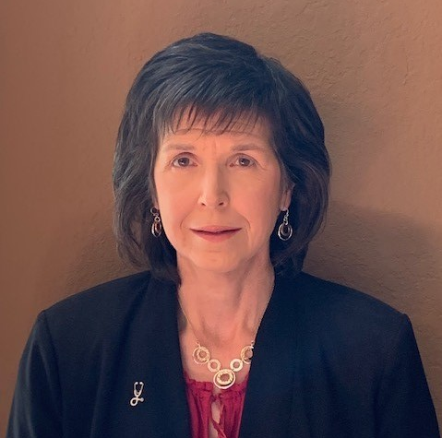

Meet the Speakers
Nelita Iuppa, DNP, MS, RN-BC, FHIMSS
Melanie Turner, MSN
Robert Steele, BSN, CPC, SHIMSS
Associate Vice President, App Services, UAB Medicine
Senior Director, Clinical Applications
Ann & Robert H. Lurie Children's Hospital of Chicago
ACNIO – Nursing Informatics, The Cleveland Clinic

Slide 6

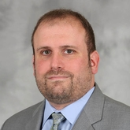
Speakers Supporting Discussion
Lee Kim, JD CISSP CIPP/US FHIMSS
Mitch Parker, MBA, CISSP
Senior Principal, Cybersecurity and Privacy HIMSS
Chief Information Security Officer/Executive Director
Indiana University Health

Slide 7
Intro
Welcome to our Cyber Readiness event.
Today we will talk about nurses and informatics professionals’ roles in cyber events. We will discuss the impacts of events on nursing practice as well as preparation for and response to events. You will leave this event with ideas and resources for enhancing practice, and facilitating a dialog in your own organization around key preparation tasks to consider.
Today’s objectives include (and maybe post to its own slide?):
Understand short and long term impact of major cyber attacks on nursing practice and steps nursing can take to protect their work.
Identify and plan business continuity tasks for mission critical system and resources for unplanned cyber outage events.
Takeaway a key talking point resource to host nursing specific planning sessions in your organization.
We will utilize a scenario to help frame our discussions today. We want this session to be highly interactive so we can learn from each other. We will be using polls and chat to help make that happen.

Slide 8

Learning Objectives
Understand short- and long-term impact of major cyber attacks on nursing practice and steps nursing can take to protect their work
Identify and plan business continuity tasks for mission critical system and resources for unplanned cyber outage events
Takeaway a key talking point resource to host nursing specific planning sessions in your organization

Slide 9
Introduction
In today’s digital environment, use of electronic systems is interwoven into every aspect of daily life
Electronic data is a lure for attackers who want to profit from this data, making healthcare delivery systems prime targets
Phishing through email is still common and an effective way of gaining access to systems. Staff remain the number one risk when they give up their usernames and passwords
Beyond email, attackers are using text, calls and social media to gain access to systems and your data. Ransomware attacks where attackers hold data hostage for a ransom increased by 94% in 2021

Slide 10
Have you worked in an organization that’s been attacked with ransomware that disabled your key clinical systems?
Notes:
Bob
Placeholder visual – pause for discussion
As we walk through this scenario….we would love to hear from some of you who have been through this as we begin talking about this scenario – chime in as we get to discussion points – share lessons learned etc.
Chat discussions are preferred

Slide 11

Let’s start our scenario
It’s a fall day in Moratal Hospital in Bytesville, CT
Grace, is a charge nurse of a busy stepdown unit
They’ve had a staff call for next shift. Grace is trying to find someone to come in while charting on her patients in the EMR.
Grace receives an SMS text on her phone. It appears to be from HR. She ignores the text message.
Grace receives an email that appears to be from HR about an urgent change in time off policies everyone must read. Her husband calls to remind her to vote. While talking to her husband, she clicks on the link and then….

Slide 12
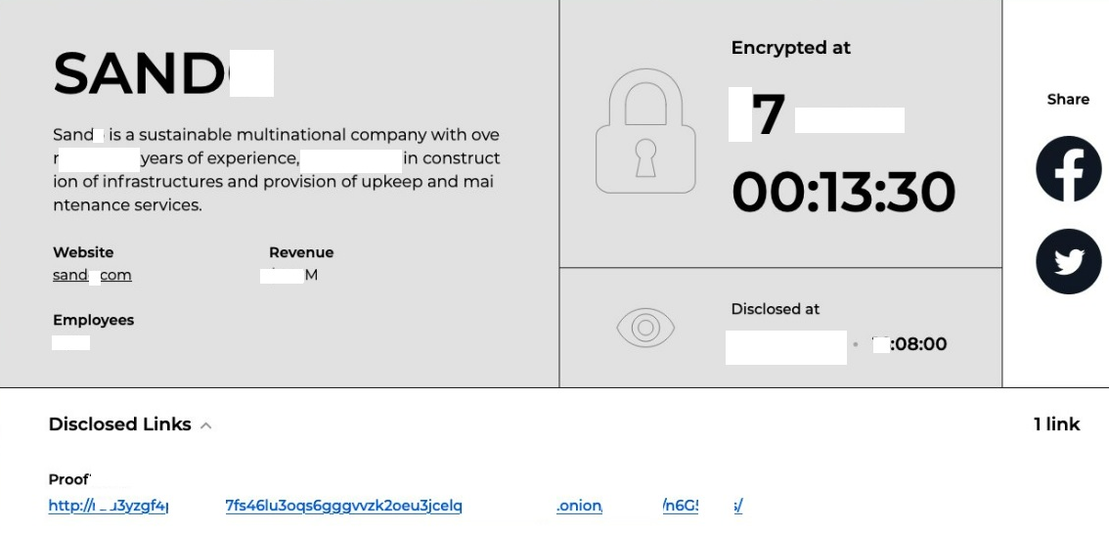
Grace sees this

Slide 13
Do you have a nursing-specific business continuity plan?
Notes:
Yes, No, Not sure

Slide 14

Grace’s reaction
Grace tries to regain control of her computer for several minutes. She can’t. The only thing she can do is turn the computer off.
It’s now 3:45PM. Grace posts a sticky note on her workstation which states, “Computer down. IT to fix. Do not use.”
Grace leaves for the day and tells the oncoming nurses she’s leaving to go vote. She mentions that her computer is down and instructs them to use the other workstation.
Do
Not
Use

Slide 15
Cyber Response
Let’s stop and talk about Grace’s actions, your poll answers and next steps.
Discussion points here:
Carefully examine all messages (email or text) with links before clicking.
Throw out and see how many people are familiar with the term BCP (Business Continuity Plan) is? Most only familiar with “Disaster Plan” and maybe discuss bow this may/could differ.
Staffing Plans
  Do you need extra staff to work in a manual environment
  Do you have access to your staff schedules in an event
Notes:
Discussion

Slide 16
Discussion Points
Carefully examine all messages
Familiarity with “Business Continuity”
Staffing Plans
  Do you need extra staff to work in a manual environment
  Do you have access to your staff schedules in an event

Slide 17

Back to our scenario at Moratal Hospital
It’s night shift on the busy step-down unit.
Hank is a staff nurse who’s working with several monitored patients.
Hank noticed some of the values from the physiologic monitors flowing into the EMR don’t match what he’s seeing on the central station. He’s also had to reset the alarm settings several times as they are going off inappropriately.
Hank is trying to complete his electronic documentation and is frustrated at how slow the system is. The system freezes and then…..

Slide 18
Hank’s Computer Screen

Slide 19

Hank’s Reaction
Hank immediately calls the IT helpdesk. Unfortunately, no one answers, and he leaves a voicemail.
Jack from the IT helpdesk calls back an hour later. But Hank misses the call since he’s helping a patient.
Hank calls back when free and this time connects to Jack

Slide 20
Were you aware that medical devices such as physiologic monitors and IV pumps could be targets of cyber attackers?

Slide 21
Scenario Update – Throughout the Hospital
Nurses and other staff cannot access their computers. The electronic health record can’t be used for orders or documentation.
Lab and radiology information systems are not available.
A patient undergoes an MRI scan. The radiology technician completes the scan, but unable to push the MRI study result.
By early morning, IV pumps can’t access the network to get to drug libraries.
IT is flooded with calls. Short staffed and with no security leader hired, they struggle to determine the source of all the issues and respond.

Slide 22
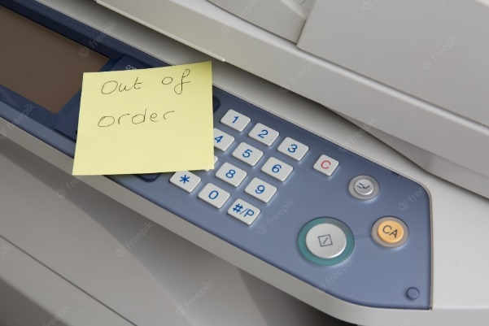
Cyber Response
Let’s stop and talk about Hanks actions, your poll answers and next steps.
Discussion points:
Managing care for patients manually
  Downtime forms for patient charting (box on each unit)
    Who updates these forms as practice changes?
  How will orders be recorded and communicated to departments
  How will results be received and process
Assign new roles specific to the event
  Runners
  Communication Leads
  Chart Checkers/Assembly
Contact information offline
  Do you have staff and leader contact information outside of systems
  Do you have an emergency escalation plan for event response

Slide 23
Cyber Response
Additional discussion points:
Organizational and nursing policies
  What changes for nursing when documenting on paper
  Without electronic decision support, what safety practices change
  What data must be recovered into systems when service is restored
  If there is MDI involvement – what is backup for integration to ensure safe monitoring and patient care?

Slide 24
Discussion Points
Managing care for patients manually
Alternative Staffing Plans
Assign temporary roles
Contact information
Organizational and nursing policies

Slide 25
Scenario Update - Throughout at the Hospital
The senior hospital administrator is called. Patients coming to the emergency room have to be diverted to a nearby hospital. Patient safety is at risk.
The nurse leader on call advises the leadership team that patients are being diverted and manual processes are being implemented.
The staff nurses struggle to remember which medications the patients are in need of overnight and ask the patients what they are taking. There are no paper backups.

Slide 26
Cyber Response
Let’s stop and talk about organizational responses.
Managing patient volumes
  Do you have agreements with neighboring hospitals to accept patient transfers. What if you are the “Receiving” Organization? Does your IT department have agreements for outside vendor or mutual support.
  Will you cancel outpatient visits and surgeries
  If diversion or transfer is implemented, how/what information is sent with patient to receiving facility?

Slide 27
Cyber Response
Organizational Impact
Financial implications
  Delayed billing when systems are down
  Lost revenue for canceled surgeries and procedures
  Extra labor cost to run in manual modes
  Compromised patient and or personnel information
  Ransom request
    Cost to mitigate (Some statistics show average of $211 per compromised record)
  Schedules, timekeeping and payroll/direct deposit

Slide 28
Discussion Points
Patient Volume
Financial Considerations
Scheduling, Diversion and Closure

Slide 29
Ultimate Costs
Cost to Organization: Having to pay ransom, lost productivity, business, lost reputation, and trust
Cost to Patient: Lost or compromised PHI and identity, months/years of stolen information being a risk to use in the future. Potential misuse of information: Health scare to obtain money from individual, financial against bank accounts or loans, risk to people in your network being scammed “we are calling relating to your mom’s cancer diagnosis…”
Cost to Caregivers: embarrassment, lost productivity, potential errors with incomplete records, stressful downtime workarounds, lack of familiarity and safety checks with manual processes.

Slide 30
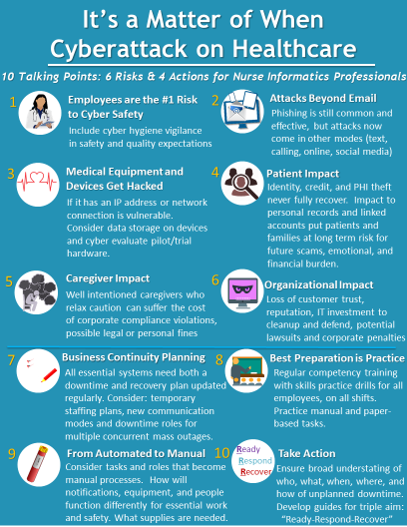
Talking Points for the Nursing Informatics Professional

Slide 31
Wrap-Up Closing statements & thanks
This concludes today’s discussion of “it’s a matter of when: ransomware attack responses for the nursing informatics professional”
We hope you enjoyed today’s session. All registered participants will be sent a brief survey after this event to provide your feedback and offer suggestions for future topics related to cyber security in nursing.
We are unable to offer continuing credit for today’s event but we have created a Talking Point Reference guide so that you can go back to your own organization and dive deeper into these important topics we covered here today. This document will be sent to your registered email with the post-event survey.
On behalf of the HIMSS Nursing Informatics Committee, we thank you all for your time and participation in today’s event

Slide 32
End of changes
Left the last slides for reference to make sure I didn’t miss any of our key discussion points in the new updates

Slide 33
Discussion
Key Nursing Considerations
Staffing Plans
  Do you need extra staff to work in a manual environment
  Do you have access to your staff schedules in an event
  Downtime forms – Where and supply levels on hand (Documentation, Discharge Inst. Transfer forms etc.) . If prolonged how/where, agreements in place to obtain additional.
  Personal – What about Time keeping for payroll?
Contact information offline
  Do you have staff and leader contact information outside of systems
  Do you have an emergency escalation plan for event response
Managing patient volumes
  Do you have agreements with neighboring hospitals to accept patient transfers. What if you are the “Receiving” Organization? Does your IT department have agreements for outside vendor or mutual support.
  Will you cancel outpatient visits and surgeries
  If diversion or transfer is implemented, how/what information is sent with patient to receiving facility?

Slide 34
Discussion
Key Nursing Considerations
Organizational and nursing policies
  What changes for nursing when documenting on paper
  Without electronic decision support, what safety practices change
  What data must be recovered into systems when service is restored
  If there is MDI involvement – what is backup for integration to ensure safe monitoring and patient care?
  Be interesting to throw out and see how many people are familiar with the term BCP (Business Continuity Plan) is? Most only familiar with “Disaster Plan” and maybe discuss bow this may/could differ.
Managing care for patients manually
  Downtime forms for patient charting (box on each unit)
    Who updates these forms as practice changes?
  How will orders be recorded and communicated to departments
  How will results be received and process

Slide 35
Discussion
Organizational Impact
Financial implications
  Delayed billing when systems are down
  Lost revenue for canceled surgeries and procedures
  Extra labor cost to run in manual modes
  Compromised patient and or personnel information
  Ransom request
    Cost to mitigate (Some statistics show average of $211 per compromised record)
  Schedules, timekeeping and payroll/direct deposit.

Slide 36
Nelita’s added Discussion thoughts
Cost to Organization: Having to pay ransom, lost productivity/business, lost reputation
Cost to Patient: Lost/compromised PHI and identity, months/years of stolen information being a risk to use in the future. Potential misuse of information: Health scare to obtain money from individual, financial against bank accounts or loans, risk to people in your network being scammed “we are calling relating to your mom’s cancer diagnosis…”
Cost to Caregivers: embarrassment, lost productivity, potential errors with incomplete records, stressful downtime workarounds, lack of familiarity and safety checks with manual processes.

Slide 37
Mturner Scenario Notes
Need to synch dates/years throughout story
Recommend reducing detail in initial story, to help focus on key points
Take out some of the IT detail to focus more on nursing needs/focus
Really like the add of slide 13
I too thought about length and detail in scenario. ☺ Not sure methodology: Read part and open for discussion or read through and then open up. Just for a first pass, I read through it beginning to end out loud , and timed = 5 min. 30 Sec. reading non-stop. Just as a baseline, as we look at options.
In the “story” it is mentioned very lightly and blended about “Monitors” etc. I think maybe embellish on that a little ….. More “personal” this could happen and affect negatively the care one is providing for a patient – Pt. Safety issue. (Maybe something like – “Data/measurements seen on moniroting devices do not match patients' condition/status” or “Alarms firing repeatedly in error”

Slide 38
Nelita Notes 8/29/2022
We really don’t call out any points of ransomware in this scenario. Anything more we can do with the screen shots or write-up to call that out more and specific response tactics vs. Phishing? Maybe Hank or Grace’s screen asks for $$ to proceed?
Takeaways we originally wanted for this scenario as a whole…we need to work them into questions, discussion or to a job aid printout afterwards.
  Common course of events during ransomware - Cyber readiness for nurses goes beyond email phishing
  Typical downtime considerations for nurses - Major categories and topics to consider in your plan
  Discussions you should have locally - Understanding the sequence of events
Pre-Event takeaways:
  Always call-in malfunctioning equipment in real time. Never leave a shift without a formal resolution ticket number.
  Know your downtime processes
    Some specific details:
      Downtime forms – Where and supply levels on hand (Documentation, Discharge Inst. Transfer forms etc)
      If diversion or transfer is implemented, how/what information is sent with patient to receiving facility? Inability to print!
      Personal – What about Time keeping for payroll?
  Never click links you don’t recognize
    Maybe hint/tip/trick about setting up e-mail with rule for “externally received e-mails” to heighten origin and risk?

Slide 39
Discussion
Open discussion of problems, solutions, what to do
Resources
  ANIA has a Guide and Toolkit Nursing Downtime Preparedness: from SAFER Guides to Practice ANIA Guides and Toolkits | American Nursing Informatics Association
  Hospital Downtime Preparedness Checklist healthcare-system-cybersecurity-incident-considerations-hospital-downtime-preparedness-checklist.pdf (hhs.gov)
  Mass General Downtime Toolkit downtime-toolkit.pdf (massgeneral.org)

Slide 40
Thank you for joining!
Upcoming HIMSS Nursing Informatics Events & Deadlines:
  Committee application process ends October 25
  HIMSS Nursing Informatics Workforce Survey open through October 31
  October 25 Coffee with the HIMSS Nursing Informatics Committee: Future Workforce
  November 8 Coffee with the HIMSS Nursing Informatics Committee: Analytics
  Questions on anything presented today? Contact me at Cait.Obenauf@himss.org

